Slide 1
CIS8695 Managing Big Data Analytics
Nasim Mousavi
Assistant Professor
J. Mack Robinson College of Business
Georgia State University
nmousavi@gsu.edu

Slide 2
Announcements
Group team selection and proposal are due on January 25th at 11:59 PM
Complete the google form in iCollege!
I will post the second homework tomorrow and it will be due on Feb 1st at 5:30 PM.
Our next class will be in room 610 instead of 1203!

Slide 3
K Nearest Neighbors (KNN)

Slide 4
KNN: Basic Idea
Simple idea: classify a record like similar records
If it walks like a duck, quacks like a duck, then it’s probably a duck
Compute Distance
Test Record
Training Records

Slide 5
KNN: Basic Idea
Relies on the idea that similar data points tend to have similar labels or values.
For a given record to be classified, identify nearby records
“Near” means records with similar predictor values X₁, X₂, … X_{p}
Classify the record as whatever the predominant class is among the nearby records (the “neighbors”)

Slide 6
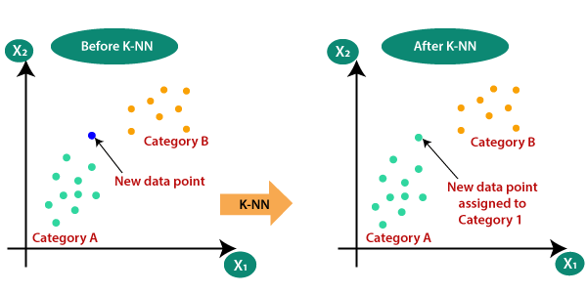
KNN: Basic Idea

Slide 7
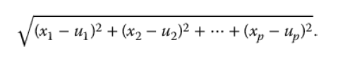
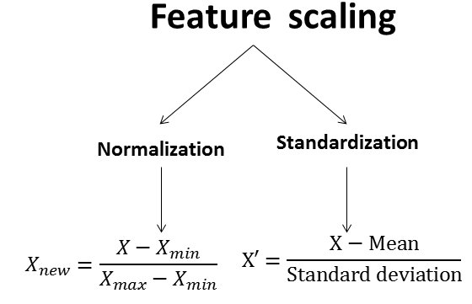
How to Measure “Nearby”?
The most popular distance measure is Euclidean distance
Typically, predictor variables are first normalized (= standardized) to put them on comparable scales
Otherwise, metrics with large scales dominate

Slide 8
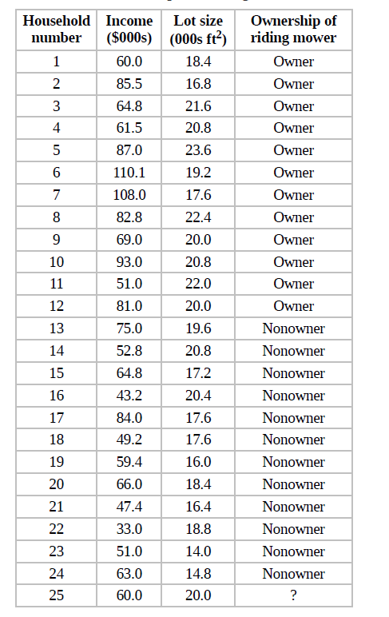
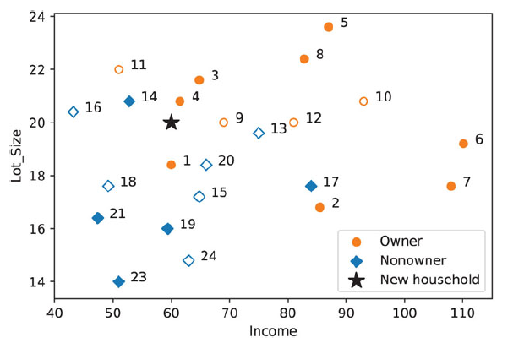
Example
A riding mower company wants to classify families to those likely to purchase a mower and not purchasing

Slide 9
Example
If k=1, the closest neighbor is #4
The closest neighbor is owner, so the new household is classified as owner
If k=3, the three closest neighbors are #4, #14, & #1
The majority vote is owner, so the new household is classified as owner

Slide 10
Choosing k
K is the number of nearby neighbors to be used to classify the new record
K=1 means use the single nearest record
K=5 means use the 5 nearest records
Low values of k (1, 3, …) capture local structure in data (but also noise)
High values of k provide more smoothing, less noise, but may miss local structure

Slide 11
Choosing K
Typically choose that value of k which has lowest error rate in validation data
Typically values of k fall in the range of 1-20
Usually use odd numbers to avoid ties
The more complex the dataset, the lower the optimum value of k

Slide 12
Using K-NN for Prediction (for Numerical Outcome)
Instead of “majority vote determines class” use average of response values
May be a weighted average, weight decreasing with distance

Slide 13
Advantages
Data-driven, not model-driven
Makes no assumptions about the data
Effective at capturing complex interactions among variables without having to define a statistical model

Slide 14
Shortcomings
Required size of training set increases exponentially with # of predictors, p
This is because expected distance to nearest neighbor increases with p
With large vector of predictors, all records end up “far away” from each other
In a large training set, it takes a long time to find distances to all the neighbors and then identify the nearest one(s)
These constitute “curse of dimensionality”

Slide 15
Naïve Bayes

Slide 16
Naïve Bayes
A probabilistic classification algorithm based on Bayes’ Theorem.
Describes the probability of an event, based on prior knowledge of conditions that might be related to the event.
Highly used in text classification

Slide 17
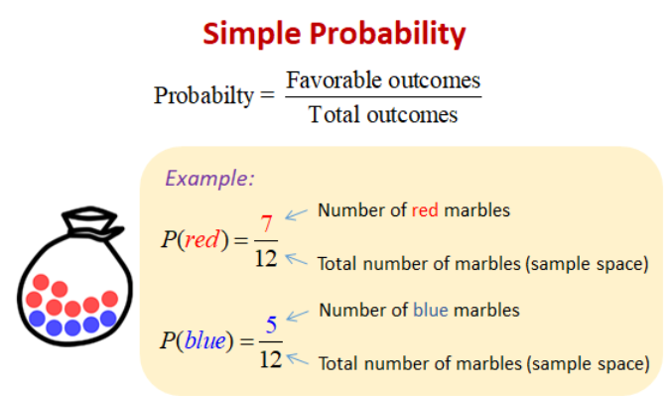
Probability
P(A): A measure of the likelihood of an event to occur

Slide 18
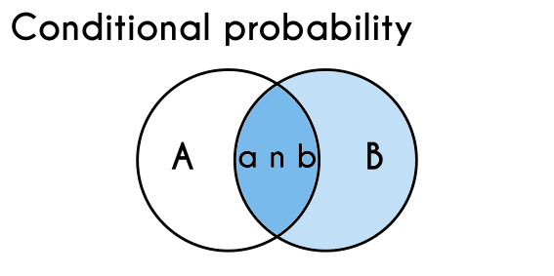

Conditional Probability
Probability of event A given that event B has occurred
$$P\left(A | B\right)=\frac{P(A and B)}{P(B)}$$

Slide 19
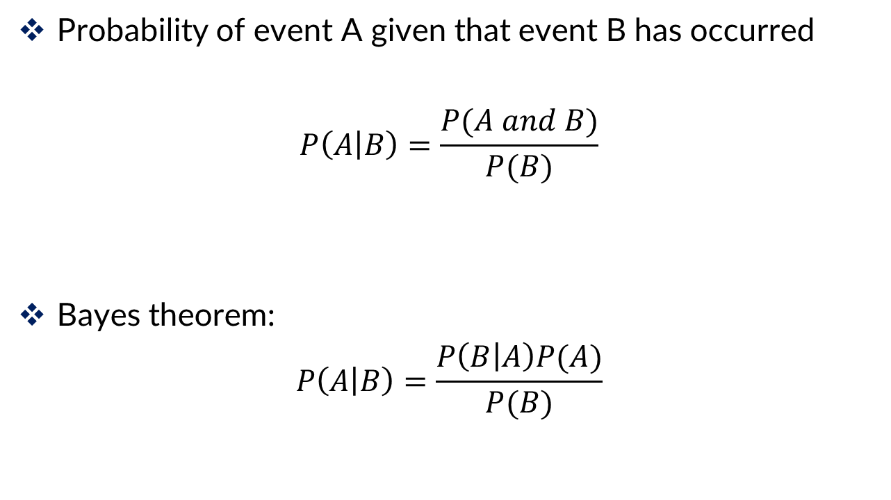
Conditional Probability
Probability of event A given that event B has occurred
$$P\left(A | B\right)=\frac{P(A and B)}{P(B)}$$
Bayes theorem:
$$P\left(A | B\right)=\frac{P\left(B | A\right)P(A)}{P(B)}$$

Slide 20
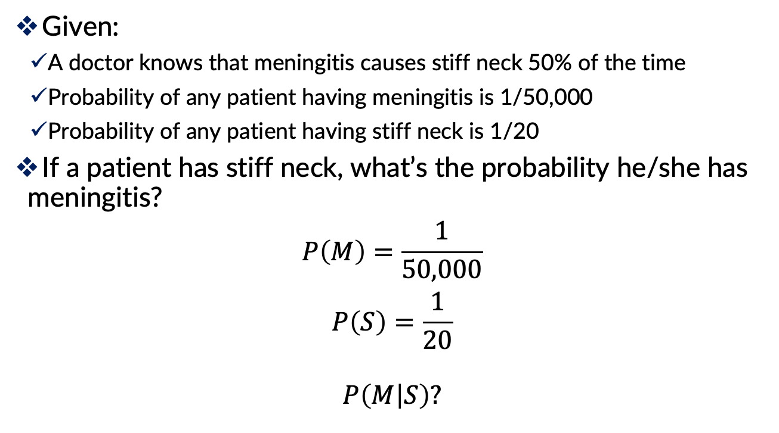
Example
Given:
A doctor knows that meningitis causes stiff neck 50% of the time
Probability of any patient having meningitis is 1/50,000
Probability of any patient having stiff neck is 1/20
If a patient has stiff neck, what’s the probability he/she has meningitis?
$$P\left(M\right)=\frac{1}{50,000}$$
$$P\left(S\right)=\frac{1}{20}$$
$$P\left(M | S\right)?$$

Slide 21
Example
Given:
A doctor knows that meningitis causes stiff neck 50% of the time
Probability of any patient having meningitis is 1/50,000
Probability of any patient having stiff neck is 1/20
If a patient has stiff neck, what’s the probability he/she has meningitis?

Slide 22

Conditional Probability in Classification
Given a record with attributes ${(x}_{1},$ $x_{2}$, …, $x_{p})$
Goal is to predict class $C$
Specifically, we want to find the value of C that maximizes $P(C|x_{1}, x_{2}\text{, …, }x_{p})$
Can we estimate $P(C|x_{1}, x_{2}\text{, …, }x_{p})$ directly from data?

Slide 23
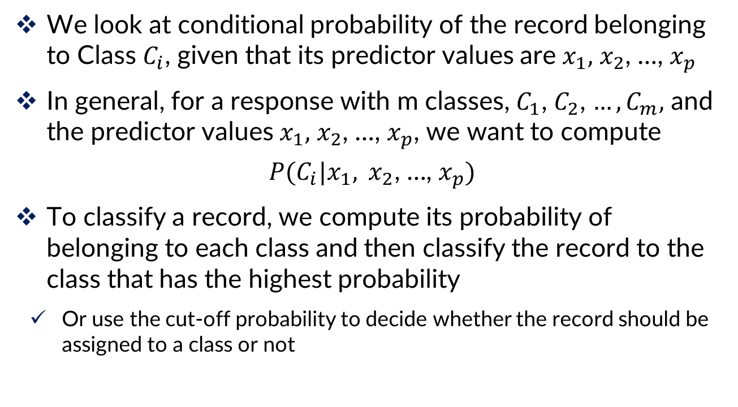
Conditional Probability
We look at conditional probability of the record belonging to Class $C_{i}$, given that its predictor values are $x_{1},$ $x_{2}$, …, $x_{p}$
In general, for a response with m classes, $C_{1}$, $C_{2}$, $…,C_{m},$ and the predictor values $x_{1},$ $x_{2}$, …, $x_{p}$, we want to compute
$$P(C_{i}|x_{1}, x_{2}\text{, …, }x_{p})$$
To classify a record, we compute its probability of belonging to each class and then classify the record to the class that has the highest probability
Or use the cut-off probability to decide whether the record should be assigned to a class or not

Slide 24
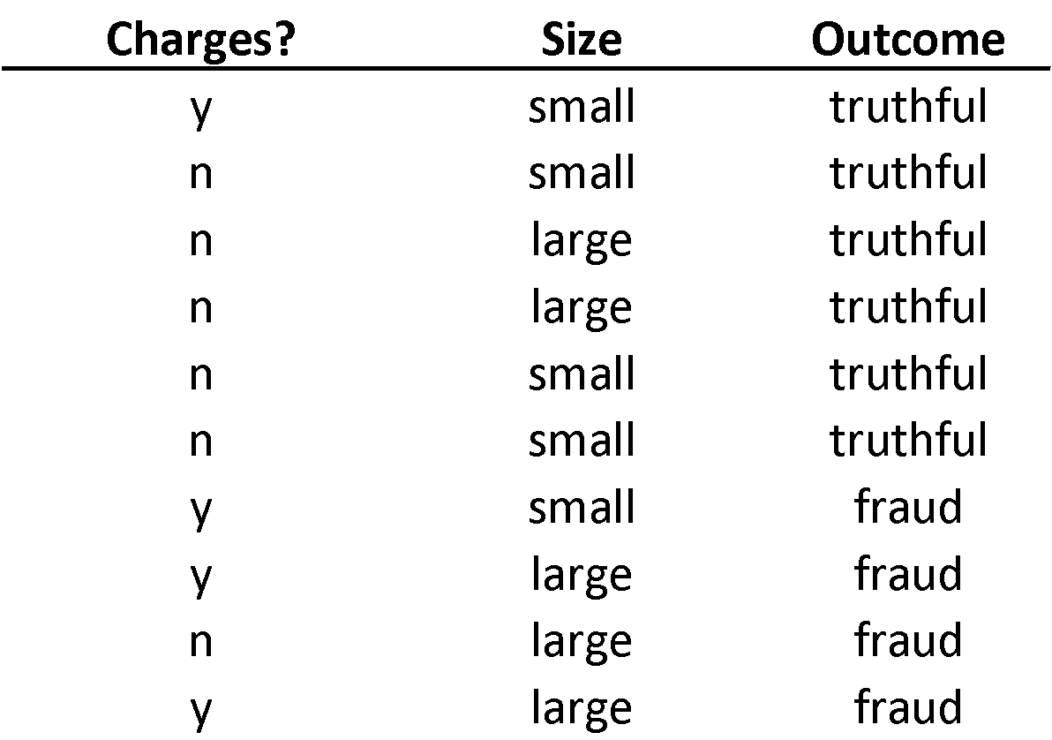
Example: Financial Fraud
Target variable:
Audit finds fraud, no fraud
Predictors:
Prior pending legal charges (yes/no)
Size of firm (small/large)

Slide 25

Exact Bayes Calculation
Goal: classify a small firm with charges filed as “fraudulent” or “truthful”
$P(Fraud|Charges=Y,Size=Small)$
There are 2 firms like that, one fraudulent and the other truthful

Slide 26
Exact Bayes Calculation
P(fraud | charges=y, size=small) = ½ = 0.50
Note: calculation is limited to the two firms matching those characteristics

Slide 27
Practical Difficulty with the Exact Bayes
The approach tries to finding all the records in the sample that are exactly like the new record to be classified
Basically, in this approach the independent variables are considered as dependent
When the number of predictors gets larger many of the records to be classified will be without exact matches

Slide 28
Solution: Naïve Bayes
In the naive Bayes solution, we no longer restrict the probability calculation to those records that match the record to be classified
Instead, we use the entire dataset
Naïve bayes considers variables independent

Slide 29

Conditional Probability
When two events are independent, $P\left(A and B\right)=P\left(A\right)∗P(B)$
$$P\left(A | B\right)=\frac{P(A and B)}{P(B)}=\frac{P\left(A\right) P(B)}{P(B)}$$

Slide 30
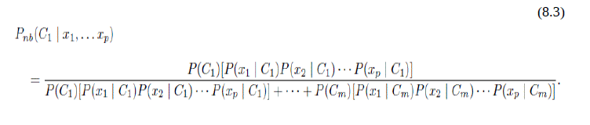
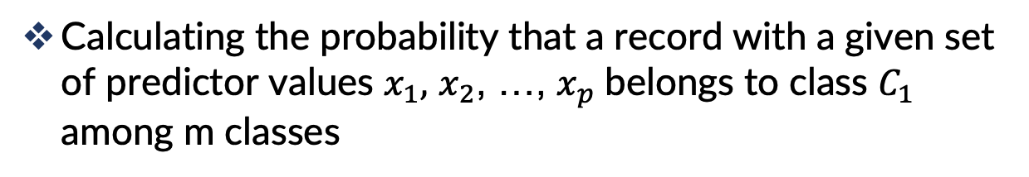
Naïve Bayes
Calculating the probability that a record with a given set of predictor values $x_{1},$ $x_{2}$, …, $x_{p}$belongs to class $C_{1}$ among m classes

Slide 31
Example: Financial Fraud
Target variable:
Audit finds fraud, no fraud
Predictors:
Prior pending legal charges (yes/no)
Size of firm (small/large)

Slide 32

Naïve Bayes Calculation
Goal: classify a small firm with charges filed as “fraudulent” or “truthful”
$P(Fraud|Charges=Y,Size=Small)$=?

Slide 33

Naïve Bayes Calculation
$P\left(Fraud | Charges=Y,Size=Small\right)=?$
Compute 2 quantities:
$P\left(Charges=Y | Fraud\right)∗P\left(Size=Small | Fraud\right)∗P(Fraud)$
Proportion of “charges = y” among frauds, times proportion of “small” among frauds, times proportion frauds= 3/4 * 1/4 * 4/10 = 0.075

Slide 34

Naïve Bayes Calculation
$P(Fraud|Charges=Y,Size=Small)$
Compute 2 quantities:
2. $P\left(Charges=Y | Turthful\right)∗P\left(Size=Small | Truthful\right)∗P(Truthful)$
Proportion “charges = y” among truthful, times prop. “small” among truthful, times prop. truthful = 1/6 * 4/6 * 6/10 = 0.067

Slide 35
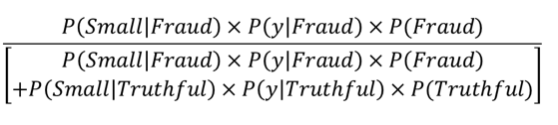
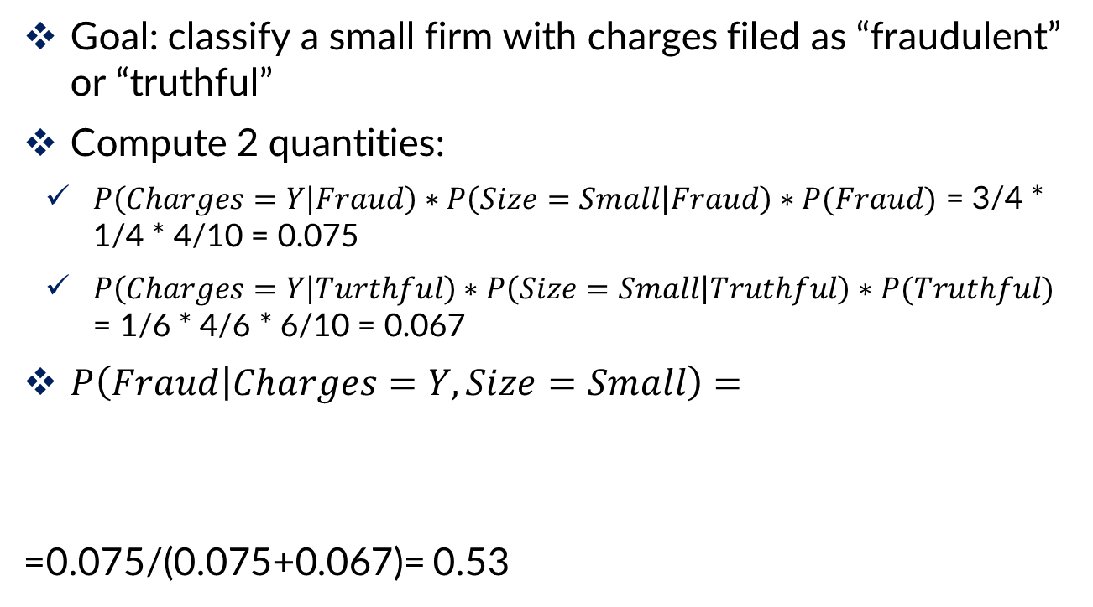
Naïve Bayes Calculation
Goal: classify a small firm with charges filed as “fraudulent” or “truthful”
Compute 2 quantities:
$P\left(Charges=Y | Fraud\right)∗P\left(Size=Small | Fraud\right)∗P(Fraud)$ = 3/4 * 1/4 * 4/10 = 0.075
$P\left(Charges=Y | Turthful\right)∗P\left(Size=Small | Truthful\right)∗P(Truthful)$ = 1/6 * 4/6 * 6/10 = 0.067
$P\left(Fraud | Charges=Y, Size=Small\right)=$
=0.075/(0.075+0.067)= 0.53

Slide 36
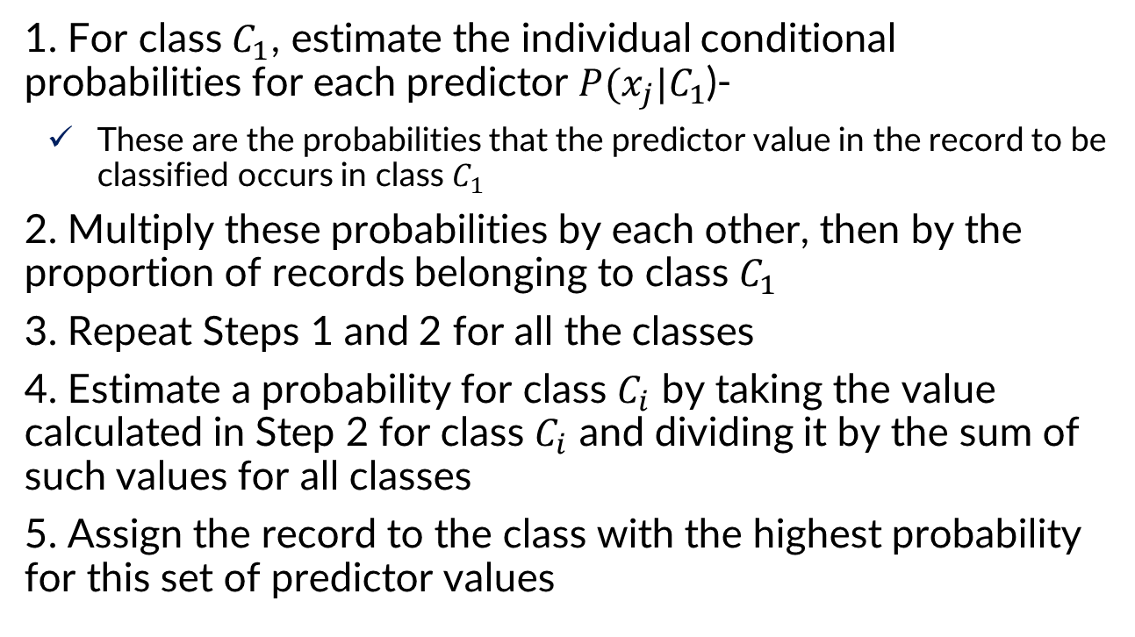
Naïve Bayes
1. For class $C_{1}$, estimate the individual conditional probabilities for each predictor $P(x_{j}|C_{1}$)-
These are the probabilities that the predictor value in the record to be classified occurs in class $C_{1}$
2. Multiply these probabilities by each other, then by the proportion of records belonging to class $C_{1}$
3. Repeat Steps 1 and 2 for all the classes
4. Estimate a probability for class $C_{i}$ by taking the value calculated in Step 2 for class $C_{i}$ and dividing it by the sum of such values for all classes
5. Assign the record to the class with the highest probability for this set of predictor values

Slide 37
Naïve Bayes Characteristics
Note that probability estimate does not differ greatly from exact
All records are used in calculations, not just those matching predictor values
This makes calculations practical in most circumstances
Relies on assumption of independence between predictor variables within each class

Slide 38
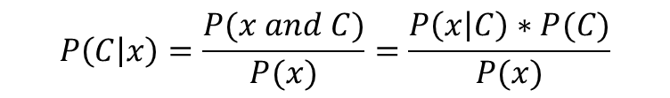
Independence Assumption
Not strictly justified (variables often correlated with one another)
Often “good enough” – ranking of probabilities is more important than unbiased estimate of actual probabilities
$$P\left(C | x\right)=\frac{P(x and C)}{P(x)}=\frac{P\left(x | C\right)∗P(C)}{P(x)}$$

Slide 39
Advantages
Handles purely categorical data well
Works well with very large data sets
Simple & computationally efficient

Slide 40
Shortcomings
Requires large number of records
Problematic when a predictor category is not present in training data
Assigns 0 probability of response, ignoring information in other variables

Slide 41
Support Vector Machine (SVM)

Slide 42
SVM
Find a linear hyperplane (decision boundary) that will separate the data

Slide 43
SVM
One possible solution

Slide 44
SVM
Another possible solution

Slide 45
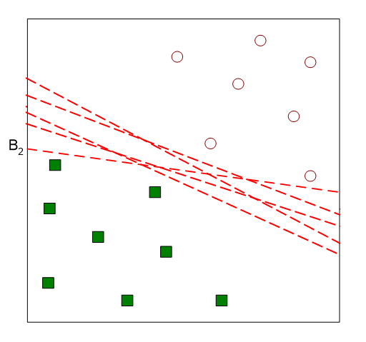
SVM
Other possible solutions

Slide 46
SVM
Which one is better? B1 or B2?
How do we define better?

Slide 47
SVM
According to SVM, we have to find the points that lie closest to both the classes
These points are known as support vectors

Slide 48
SVM
The distance between the points and the dividing line is known as margin
The aim of an SVM algorithm is to maximize this margin
When the margin reaches its maximum, the hyperplane becomes the optimal one

Slide 49
SVM
Find hyperplane maximizes the margin => B1 is better than B2

Slide 50
SVM
How do we find this hyperplane?
Measuring performance of the model using cross validation

